Slide 1
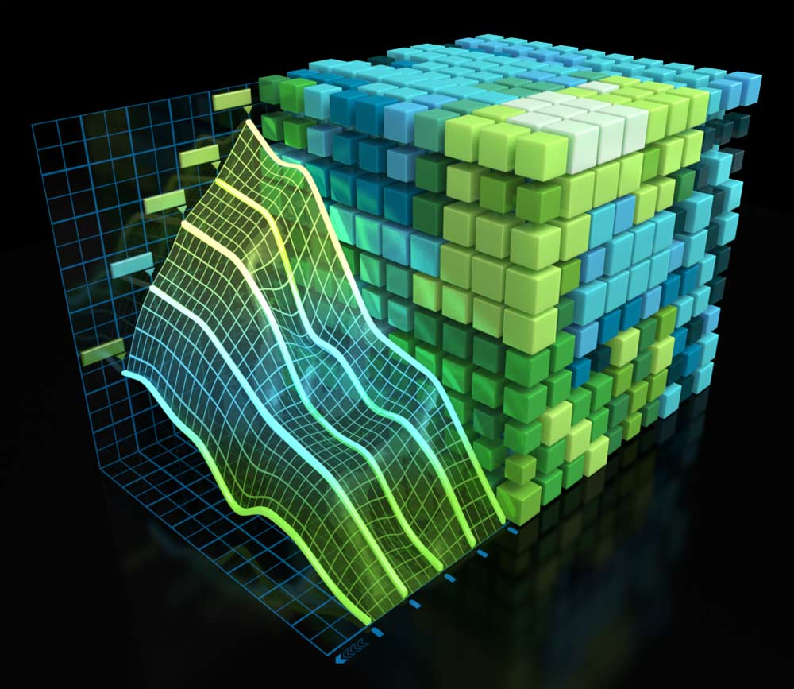
NVIDIA Profiler’s Guide
20163007
Sanghoon Kang

Slide 2
Outline
Introduction
NVIDIA Profiler
Necessity of the Profiler
User Guide
nvprof
Visual Profiler (nvvp)
Analysis
Conclusion

Slide 3
Outline
Introduction
NVIDIA Profiler
Necessity of the Profiler
User Guide
nvprof
Visual Profiler (nvvp)
Analysis
Conclusion

Slide 4
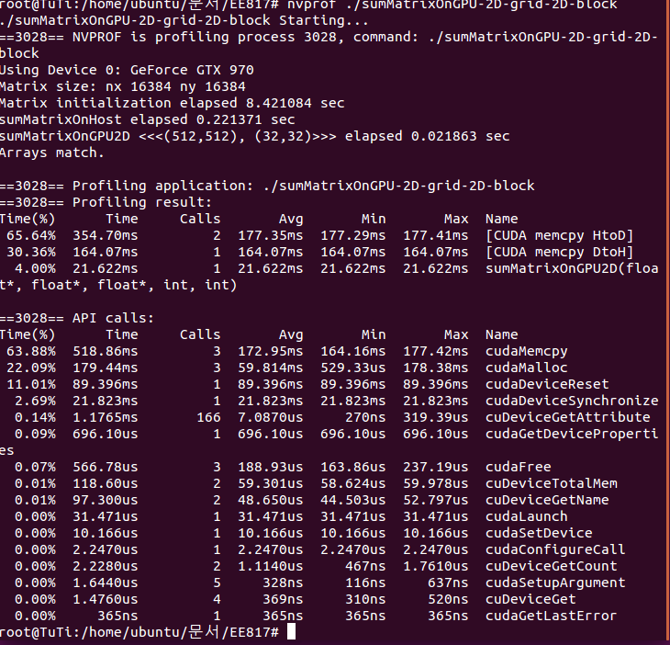
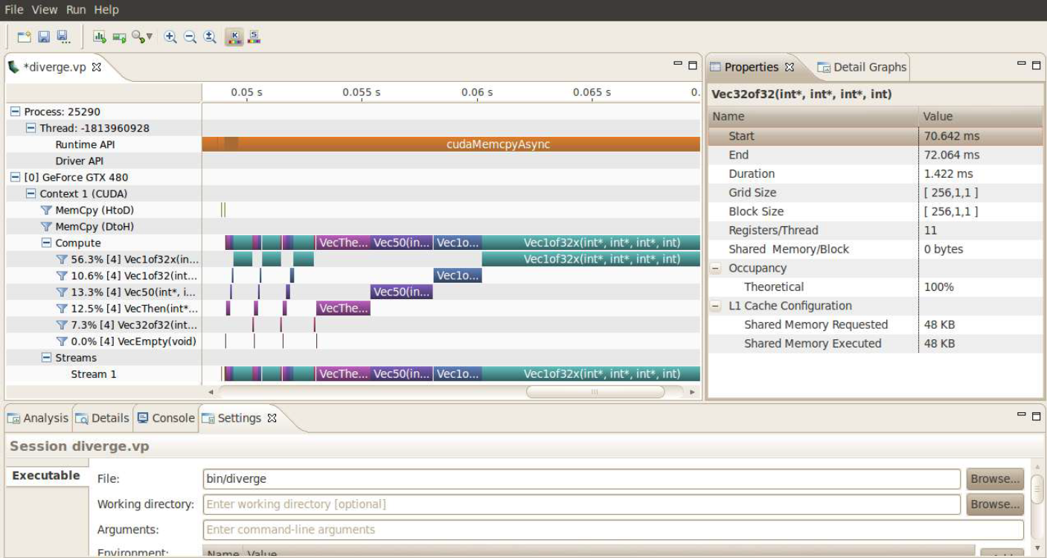
NVIDIA Profiler
1. Introduction
What is a Profiler?
Tool that enables you to understand and optimize the performance of your CUDA applications
Types of NVIDIA Profilers
nvprof
Visual Profiler (nvvp)

Slide 5
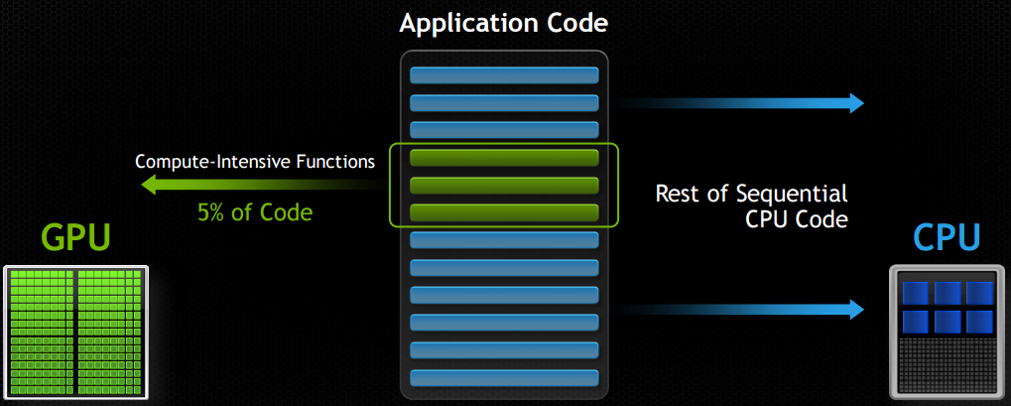
Necessity of a Profiler
1. Introduction
Application using both CPU & GPU
Performance Limiters
Memory / Instruction bandwidth
Latency of execution
➔ Need profiler to find out what limits the application’s performance (speed)

Slide 6
Outline
Introduction
NVIDIA Profiler
Necessity of the Profiler
User Guide
nvprof
Visual Profiler (nvvp)
Analysis
Conclusion

Slide 7
nvprof
2. User Guide
Terminal based profiler with textual reports
Summary of GPU & CPU activity
Trace of GPU & CPU activity
Event collection
Usage of nvprof
Terminal command
$ nvprof [ nvprof_args ] <app> [apps_args]
Argument help
$ nvprof --help

Slide 8
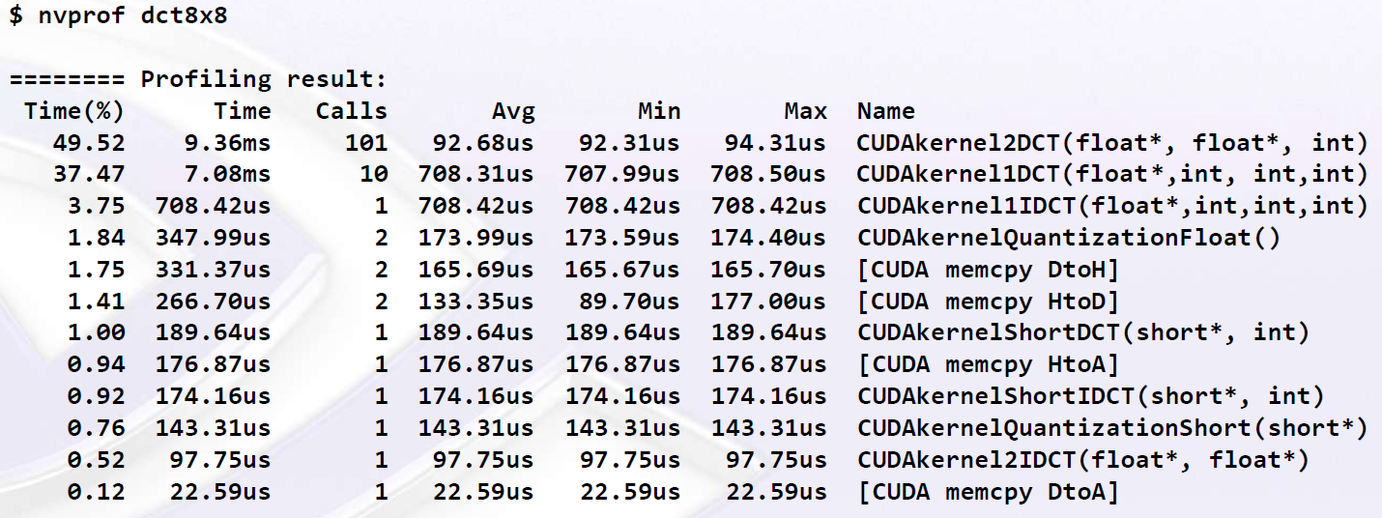
nvprof
2. User Guide
GPU Summary
Summary of each kernel functions
Number of calls
Execution time (Avg, min, max)
Time portion to the total application running time

Slide 9
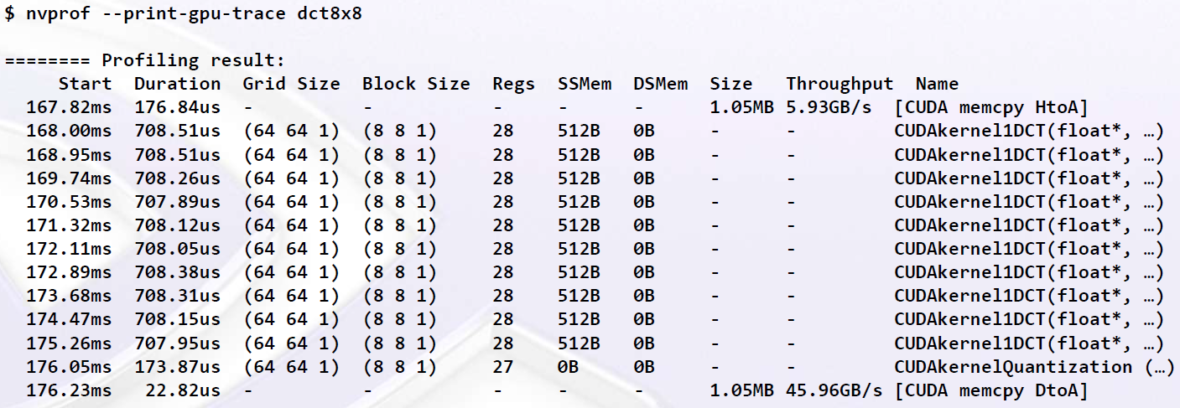
nvprof
2. User Guide
GPU Trace
More detailed analysis
Starting point, duration
Grid & block allocations
Size & Throughput of mempcy

Slide 10
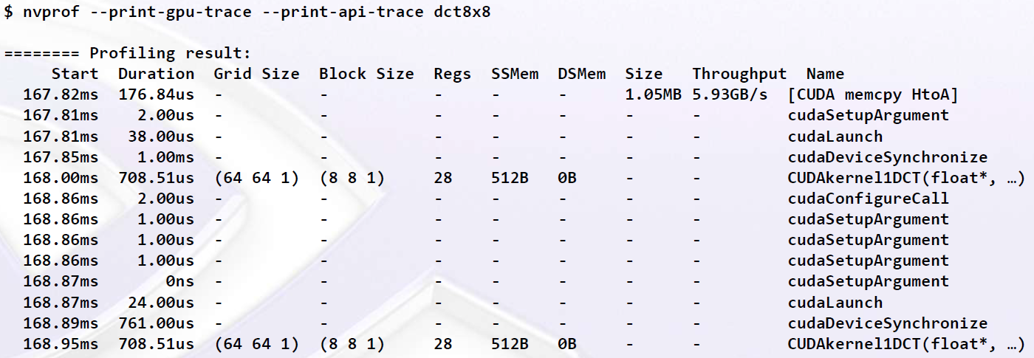
nvprof
2. User Guide
CPU / GPU Trace
Enables API functions to be printed out
Show internal kernel functions
Synchronization between CPU & GPU

Slide 11
nvprof
2. User Guide
Profile Data Import / Export
Produce profile data into a file
$ nvprof -o profile.out <app> <app args>
Import into nvprof to generate textual outputs
$ nvprof -i profile.out
$ nvprof -I profile.out --print-gpu-trace
$ nvprof -I profile.out --print-api-trace
Import into Visual Profiler
Enables graphic user interface
File menu → Import nvprof profile

Slide 12
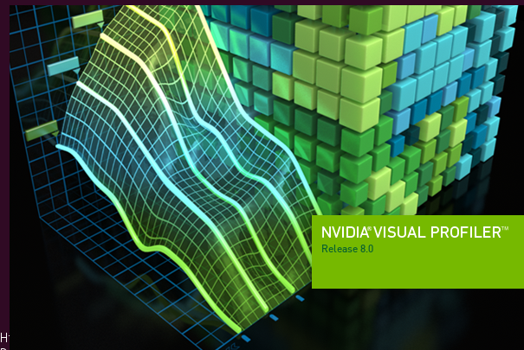
Visual Profiler
2. User Guide
Graphic User Interface (GUI) based profiler
Standalone (nvvp)
Integrated into NVIDIA Nsight Eclipse Edition (nsight)
Nvidia Nsight Visual Studio Edition
Usage of nvvp
$ nvvp

Slide 13
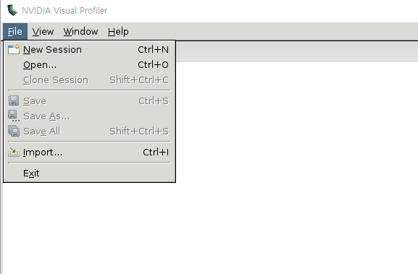
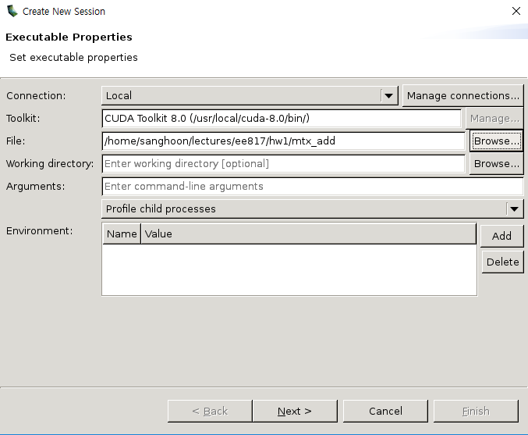
Visual Profiler
2. User Guide
Creating a New Session

Slide 14
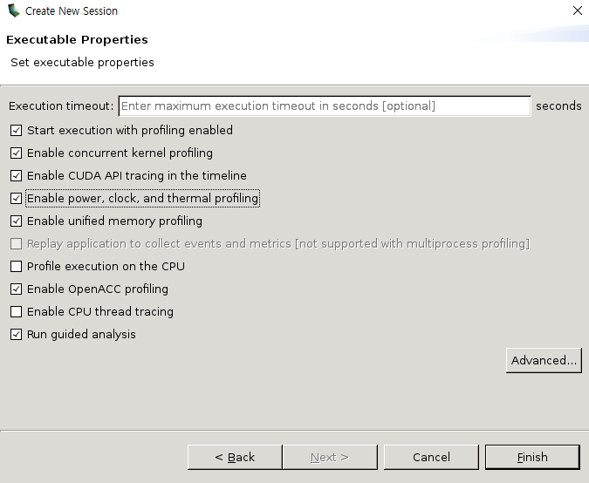
Visual Profiler
2. User Guide
Creating a New Session – Selecting Options

Slide 15
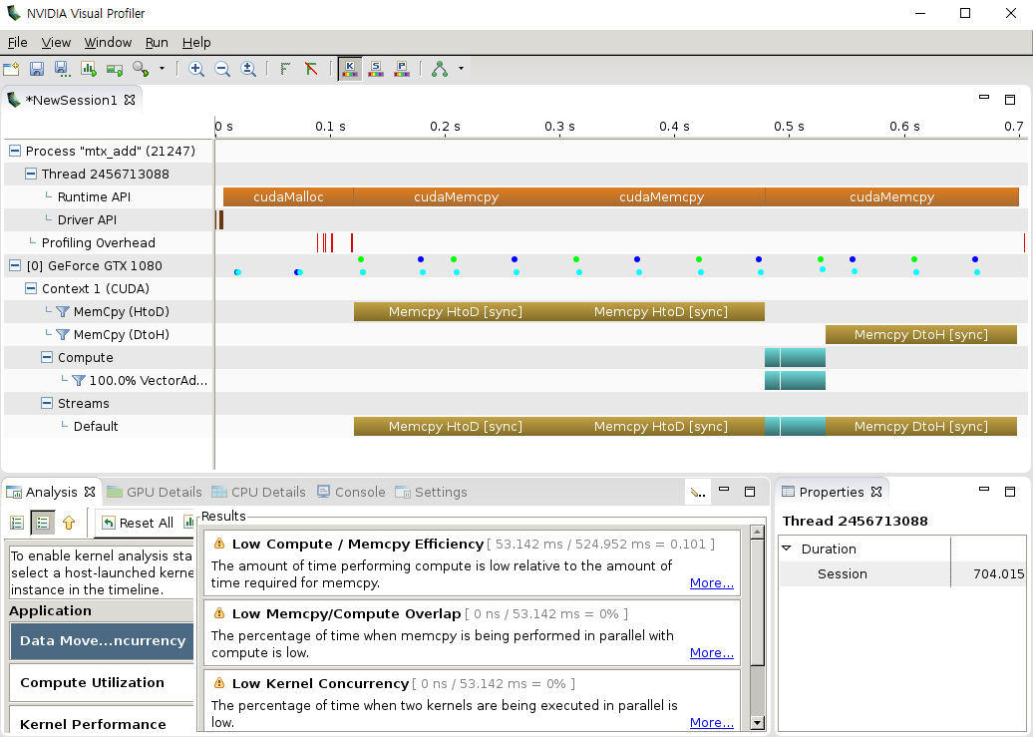
Visual Profiler
2. User Guide
Timeline

Slide 16
Visual Profiler
2. User Guide
Timeline - CPU

Slide 17
Visual Profiler
2. User Guide
Timeline - GPU

Slide 18
Visual Profiler
2. User Guide
Timeline - GPU

Slide 19
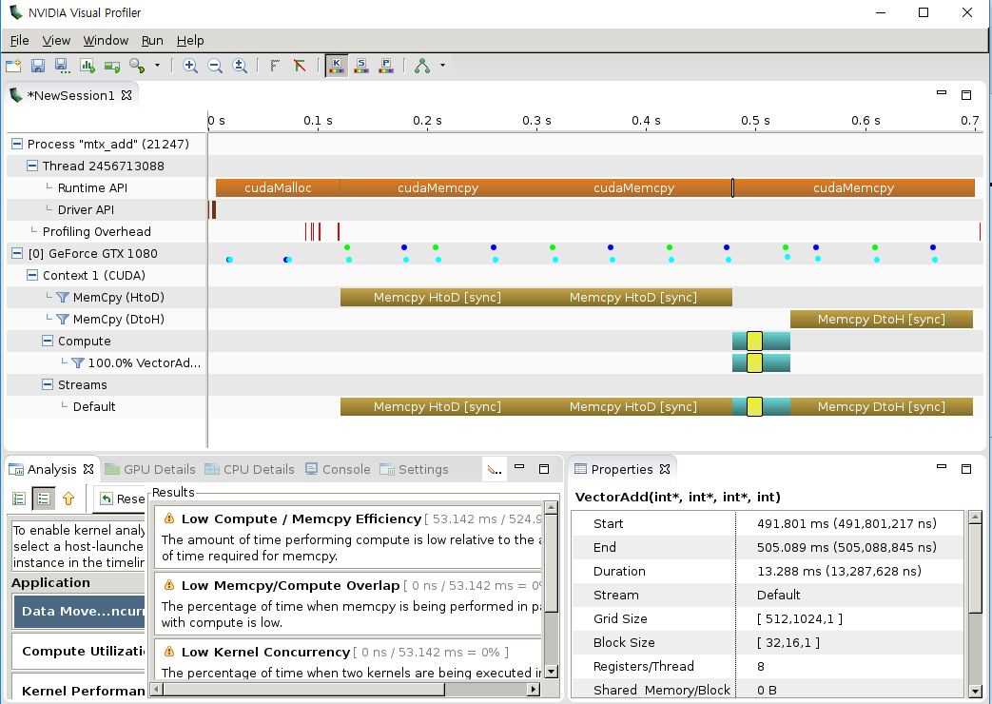
Visual Profiler
2. User Guide
Kernel Function Properties

Slide 20
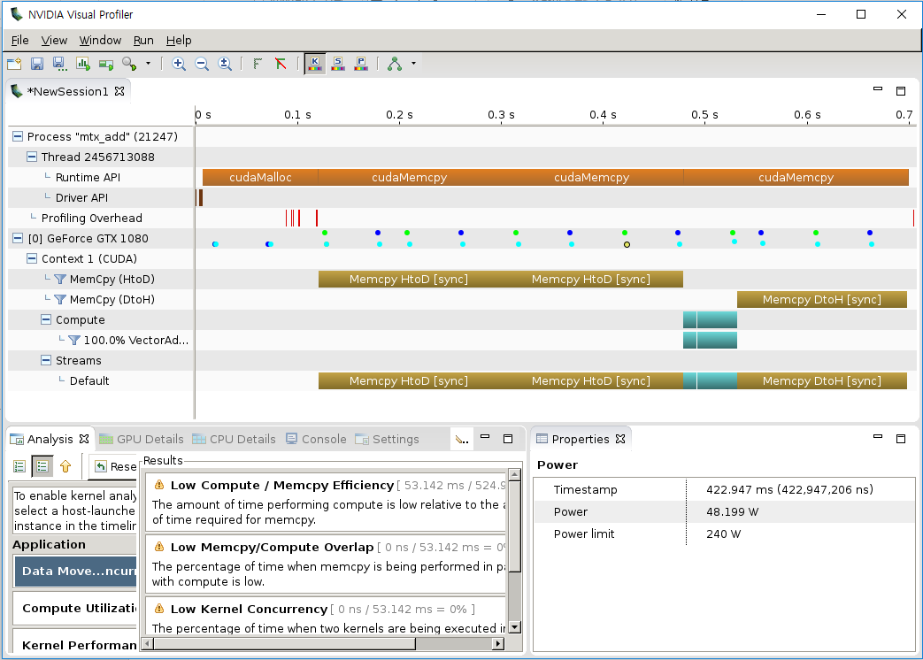
Visual Profiler
2. User Guide
Device Properties

Slide 21
Analysis
2. User Guide
Visual Inspection of Timeline
Understand CPU / GPU interactions
Is the application taking advantage of both CPU & GPU?
Is CPU waiting on GPU? Is GPU waiting on CPU?
Look for potential concurrency opportunities
Overlap memcpy and kernel
Concurrent Kernels

Slide 22
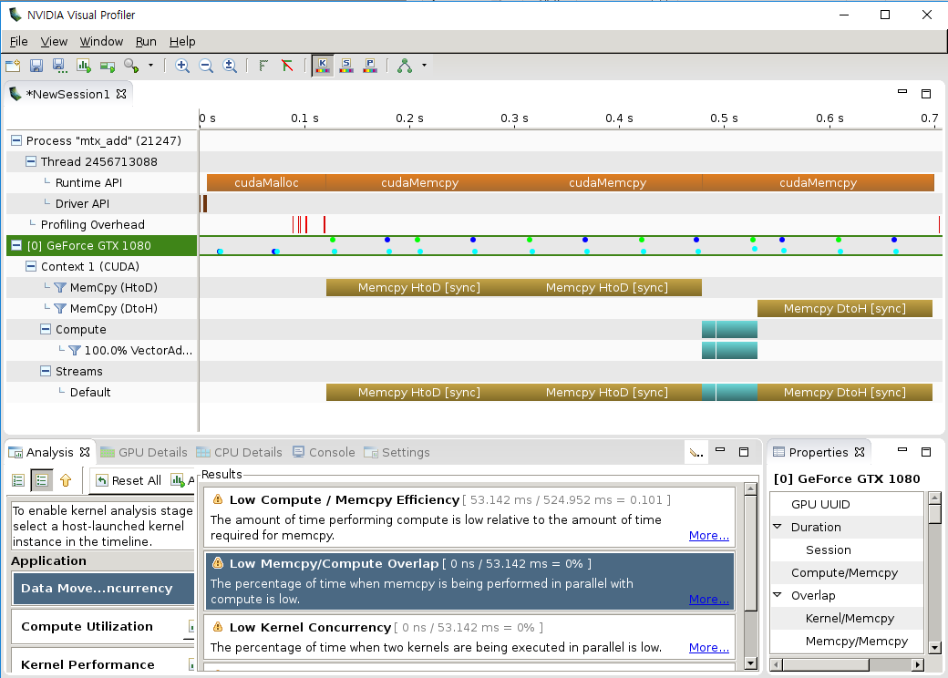
Analysis
2. User Guide
Automated Analysis

Slide 23
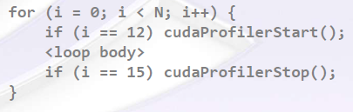
Analysis
2. User Guide
Focused Profiling
Setting region of interest (ROI)
Specify representative subset of app. Execution
Manual exploration and analysis simplified
Automated analysis focused on performance of ROI
How to?
cudaProfilerStart() / cudaProfilerStop() in the code
Include cuda_profiler_api.h

Slide 24
Outline
Introduction
NVIDIA Profiler
Necessity of the Profiler
User Guide
nvprof
Visual Profiler (nvvp)
Analysis
Conclusion

Slide 25
Conclusion
3. Conclusion
Goal of Using Profilers
Find out performance limiters of data & computation intensive applications
Optimal resource distribution across application
Overlapping procedures ➔ Latency hiding
Tools for Profiling
Nvprof
Terminal based texture profiling
Visual Profiler
GUI based profiling with timeline

